Slide 1
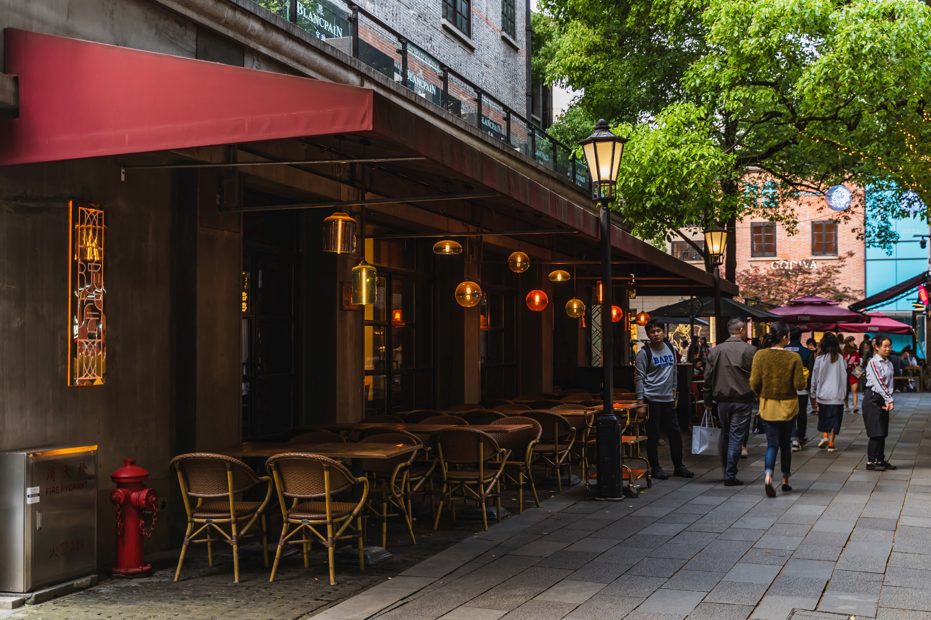
How to find a place in Shanghai to open a new coffee shop
How to find a place in Shanghai to open a new coffee shop

Slide 2
Find the right place is the most important thing to star a cafe
The right location can gather the potential costumers to the café.
The shop rent price can vary from place to place, and give an advantage to the cost.
The competitor of the same type shops to avoid the completors in the same place.

Slide 3
Data acquisition and cleaning
Scraped the 街道 names from wiki pages:https://en.wikipedia.org/wiki/Shanghai
Get the 街道 latitude and longitude data from google map as geocoder google API. Slice the data to latitude and longitude.
Get the nearby culture venues by four square apis, reorganize the data to show the numbers of the venues.
Get the house price and the Shanghai geojson file from http://datav.aliyun.com/tools/atlas/#&lat=31.769817845138945&lng=104.29901249999999&zoom=4
For the selected 街道,find the least café around them

Slide 4
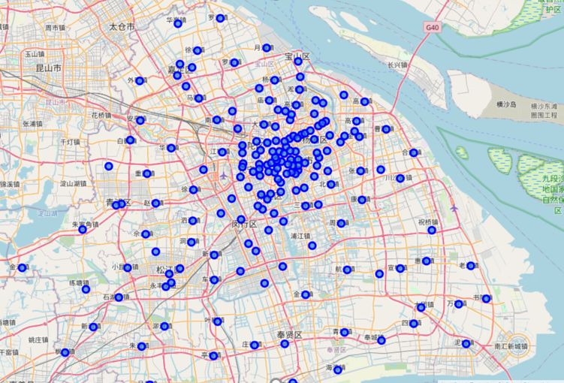
The 街道 dot in the Shanghai map
There are 140+ 街道in Shanghai.
They do not locate averagely in the space.
In order to analyze them, we first group them

Slide 5
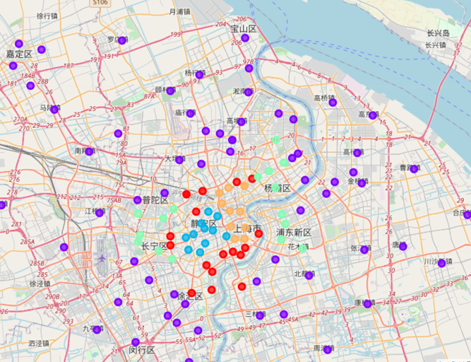
K-means to divide the data to 5 groups
The center city has more culture venues nearby
To see the detail,need to get the number of every kinds.

Slide 6
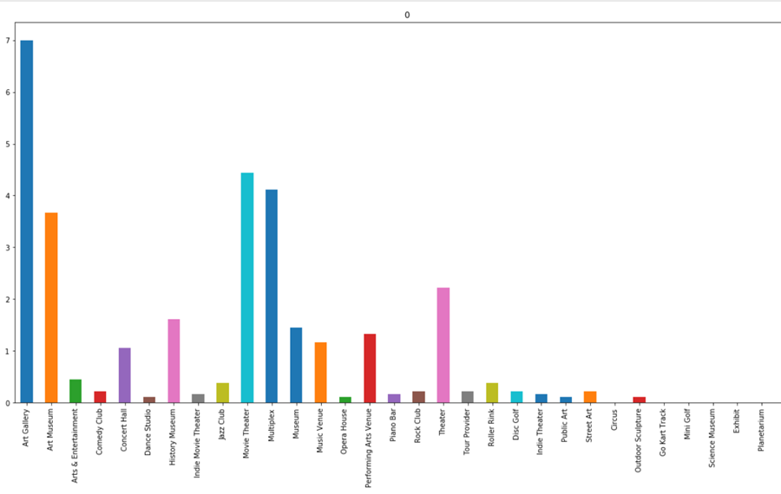
No.0 group
Average art gallery

Slide 7
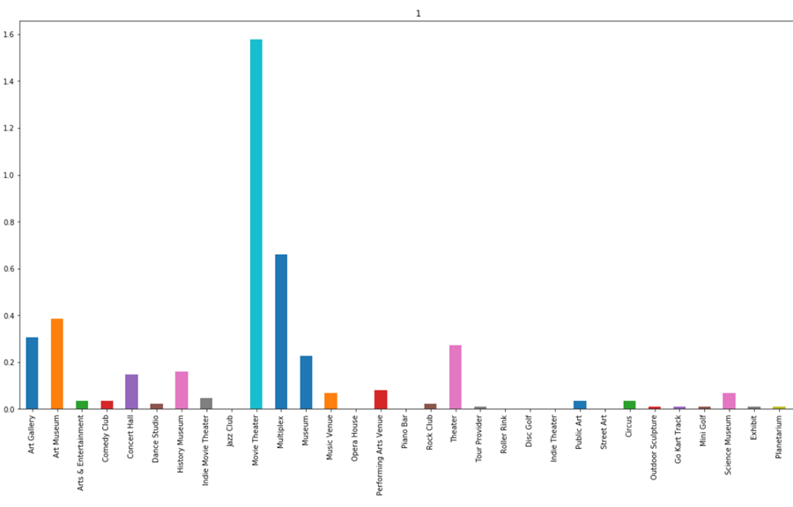
No.1 group
Not too much art venues but movie theaters

Slide 8
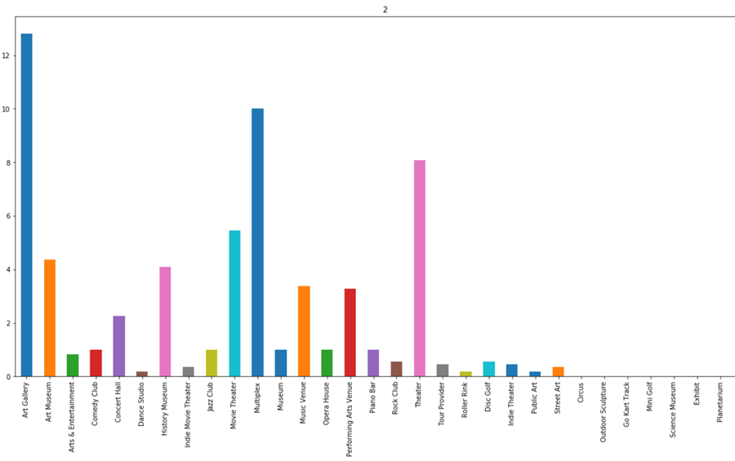
No.2 group
A lot of art venues

Slide 9
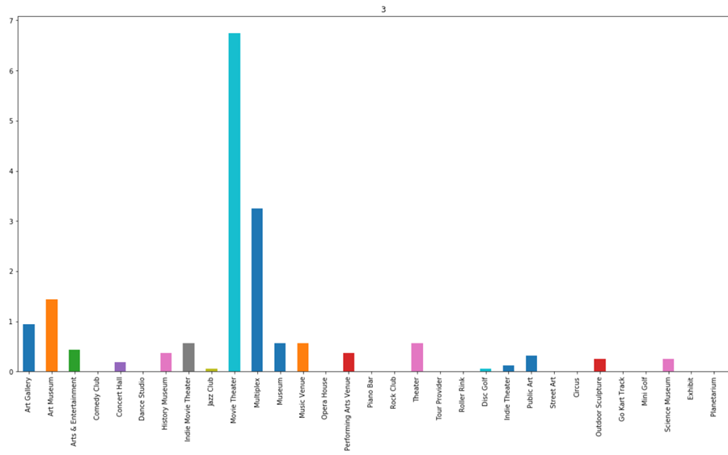
No.3 group
Not too much venues but movie theaters

Slide 10
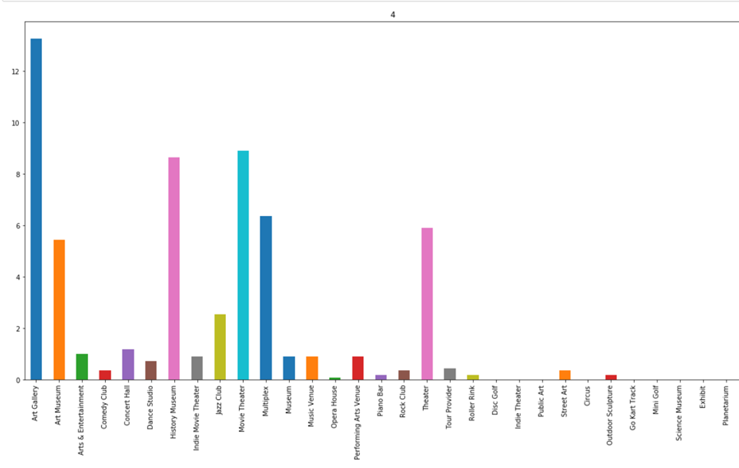
No.4 group
A lot of art venues
We concentrate our 街道 to No.2 and No.4

Slide 11
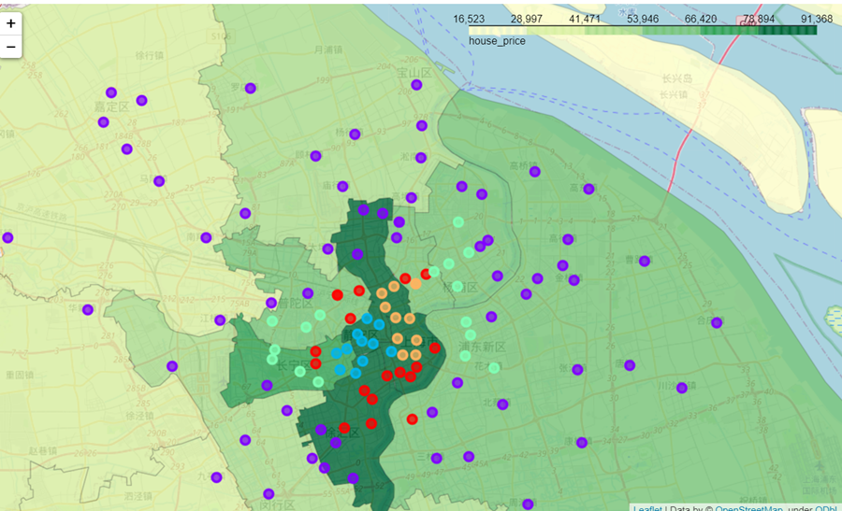
Heat map background with house price
We find 4 街道 in No.2 and No.4 group with not too high house price

Slide 12
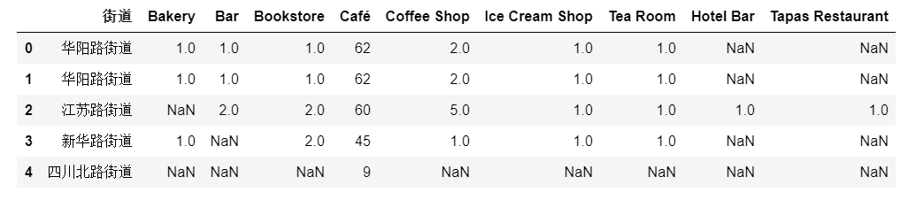
The last candidate to choose

Slide 13
Conclusion and future discussion
Four square API is a powerful tool to get various venues around the given position.
Use the venues data, we can get a rough idea about the position.
Large scale finding can help to make the decision
K-means can help to narrow the selection

